Slide 1
MongoDB Advanced Operations
Lecture 20

Slide 2
Searching in Array
………………………………
{
"_id" : ObjectId("5cc7fddee37496f1a5e7e267"),
"Pname" : "ProductK",
"Pnumber" : 45,
"Plocation" : {
"city" : "Mumbai",
"state" : "Maharashtra",
"country" : "India"
},
"Dnum" : 3
}
{
"_id" : ObjectId("5cc7fe36e37496f1a5e7e268"),
"Pname" : "ProductK",
"Pnumber" : 45,
"Plocation" : [
"Delhi",
"Mumbai",
"Pune"
],
"Dnum" : 3
}
Query: >db.project.find().pretty()
Output:
{
"_id" : ObjectId("5cc7fd66e37496f1a5e7e261"),
"Pname" : "ProductK",
"Pnumber" : 45,
"Plocation" : {
"city" : "Mumbai",
"state" : "Maharashtra",
"country" : "India"
},
"Dnum" : 3
}
{
"_id" : ObjectId("5cc7fd78e37496f1a5e7e262"),
"Pname" : "ProductX",
"Pnumber" : 10,
"Plocation" : "Delhi",
"Dnum" : 7
}……………………….

Slide 3
Searching in Array (cont.)
Query: > db.project.find({Plocation:"Delhi"}).pretty()
Output:
{
"_id" : ObjectId("5cc7fd78e37496f1a5e7e262"),
"Pname" : "ProductX",
"Pnumber" : 10,
"Plocation" : "Delhi",
"Dnum" : 7
}
{
"_id" : ObjectId("5cc7fd93e37496f1a5e7e266"),
"Pname" : "ProductA",
"Pnumber" : 32,
"Plocation" : "Delhi",
"Dnum" : 5
}………………
………………………
{
"_id" : ObjectId("5cc7fe36e37496f1a5e7e268"),
"Pname" : "ProductK",
"Pnumber" : 45,
"Plocation" : [
"Delhi",
"Mumbai",
"Pune"
],
"Dnum" : 3
}

Slide 4
Searching in Array (cont.)
Query: > db.project.find({Plocation:["Delhi","Mumbai"]}).pretty()
Output: Nothing
Query: > db.project.find({Plocation:{$all:["Delhi","Mumbai"]}}).pretty()
Output:
{
"_id" : ObjectId("5cc7fe36e37496f1a5e7e268"),
"Pname" : "ProductK",
"Pnumber" : 45,
"Plocation" : [
"Delhi",
"Mumbai",
"Pune"
],
"Dnum" : 3
}
Matches arrays that contain all elements specified in the query.

Slide 5
Searching in Array (cont.)
Query: >db.project.find({Plocation:["Delhi","Mumbai","Pune"]}).pretty()
Output:
{
"_id" : ObjectId("5cc7fe36e37496f1a5e7e268"),
"Pname" : "ProductK",
"Pnumber" : 45,
"Plocation" : [
"Delhi",
"Mumbai",
"Pune"
],
"Dnum" : 3
}
As it is entire array should be matched.

Slide 6

Searching in Array (cont.)
$elemMatch: This operator matches documents that contain an array field with at least one element that matches all the specified query criteria.
Syntax: { <field>: { $elemMatch: { <query1>, <query2>, ... } } }

Slide 7
Example - $elemMatch
"Plocation" : [
"Delhi",
"Mumbai"
],
"Dnum" : [
3,
5,
9,
15
]
}
{
"_id" : ObjectId("5cc8a3dde37496f1a5e7e26b"),
"Pname" : "ProductU",
"Pnumber" : 56,
"Plocation" : [
"Delhi",
"Mumbai"
],
"Dnum" : [
3,
15
]
}
Query: > db.project.find().pretty()
Output:
{
"_id" : ObjectId("5cc8a1f7e37496f1a5e7e269"),
"Pname" : "ProductK",
"Pnumber" : 45,
"Plocation" : [
"Delhi",
"Mumbai"
],
"Dnum" : 3
}
{
"_id" : ObjectId("5cc8a3b5e37496f1a5e7e26a"),
"Pname" : "ProductK",
"Pnumber" : 45,

Slide 8
Example - $elemMatch (cont.)
Query: > db.project.find( { Dnum: { $elemMatch: { $gte: 4, $lt: 10 } } } ).pretty()
Output:
{
"_id" : ObjectId("5cc8a3b5e37496f1a5e7e26a"),
"Pname" : "ProductK",
"Pnumber" : 45,
"Plocation" : [
"Delhi",
"Mumbai"
],
"Dnum" : [
3,
5,
9,
15
]
}

Slide 9
Searching in Embedded Document
{
"_id" : ObjectId("5cc7fddee37496f1a5e7e267"),
"Pname" : "ProductD",
"Pnumber" : 45,
"Plocation" : {
"city" : "Mumbai",
"state" : "Maharashtra",
"country" : "India"
},
"Dnum" : 3
}
{
"_id" : ObjectId("5cc7fe36e37496f1a5e7e268"),
"Pname" : "ProductK",
"Pnumber" : 45,
"Plocation" : [
"Delhi",
"Mumbai",
"Pune"
],
"Dnum" : 3
}
{
"_id" : ObjectId("5cd1c556bc9a2dc89b49c38b"),
"Pname" : "ProductK",
"Pnumber" : 45,
"Plocation" : {
"city" : "Mumbai"
},
"Dnum" : 5
}
Query: > db.project.find().pretty()
Output:
{
"_id" : ObjectId("5cc7fd66e37496f1a5e7e261"),
"Pname" : "ProductK",
"Pnumber" : 45,
"Plocation" : {
"city" : "Mumbai",
"state" : "Maharashtra",
"country" : "India"
},
"Dnum" : 3
}
{
"_id" : ObjectId("5cc7fd78e37496f1a5e7e262"),
"Pname" : "ProductX",
"Pnumber" : 10,
"Plocation" : "Delhi",
"Dnum" : 7
}
Array, not embedded document

Slide 10
Searching in Embedded Document (cont.)
Query:
>db.project.find({"Plocation.city":"Mumbai"}).pretty()
OR
> db.project.find({"Plocation.city":"Mumbai"}).pretty()
Output:
{
"_id" : ObjectId("5cc7fd66e37496f1a5e7e261"),
"Pname" : "ProductK",
"Pnumber" : 45,
"Plocation" : {
"city" : "Mumbai",
"state" : "Maharashtra",
"country" : "India"
},
"Dnum" : 3
}
{
"_id" : ObjectId("5cc7fddee37496f1a5e7e267"),
"Pname" : "ProductD",
"Pnumber" : 45,
"Plocation" : {
"city" : "Mumbai",
"state" : "Maharashtra",
"country" : "India"
},
"Dnum" : 3
}
{
"_id" : ObjectId("5cd1c556bc9a2dc89b49c38b"),
"Pname" : "ProductK",
"Pnumber" : 45,
"Plocation" : {
"city" : "Mumbai"
},
"Dnum" : 5
}
** Always refer the field embedded in another field by using a dot notation and in quotes **

Slide 11
Searching in Embedded Document (cont.)
Query:
>db.project.find({"Plocation.city":"Mumbai","Plocation.state":"Maharashtra","Plocation.country":"India"}).pretty()
OR
> db.project.find({Plocation:{city:"Mumbai",state:"Maharashtra",country:"India"}}).pretty()
Output:
{
"_id" : ObjectId("5cc7fd66e37496f1a5e7e261"),
"Pname" : "ProductK",
"Pnumber" : 45,
"Plocation" : {
"city" : "Mumbai",
"state" : "Maharashtra",
"country" : "India"
},
"Dnum" : 3
}
When we want to match exact same embedded document
{
"_id" : ObjectId("5cc7fddee37496f1a5e7e267"),
"Pname" : "ProductK",
"Pnumber" : 45,
"Plocation" : {
"city" : "Mumbai",
"state" : "Maharashtra",
"country" : "India"
},
"Dnum" : 3
}

Slide 12
Searching in Embedded Document (cont.)
Any of the query filter conditions Equality, Less than, Less than equal, Greater than, Greater than equal, Not equal, AND, OR (SLIDE 47, 48, 49) can be applied on a field embedded in another field

Slide 13
Relation in Mongo
Relation in Mongo implies how documents are logically related to each other.
Relationship Modeling
Embedded
Referenced

Slide 14
project Collection
> db.project.find().pretty()
{
"_id" : ObjectId("5cc7fd66e37496f1a5e7e261"),
"Pname" : "ProductK",
"Pnumber" : 45,
"Plocation" : {
"city" : "Mumbai",
"state" : "Maharashtra",
"country" : "India"
},
"Dnum" : 3
}
{
"_id" : ObjectId("5cc7fd78e37496f1a5e7e263"),
"Pname" : "ProductY",
"Pnumber" : 30,
"Plocation" : "Pune",
"Dnum" : 3
}
{
"_id" : ObjectId("5cc8a3dde37496f1a5e7e26b"),
"Pname" : "ProductU",
"Pnumber" : 56,
"Plocation" : [
"Delhi",
"Mumbai"
],
"Dnum" : 15
}
{
"_id" : ObjectId("5cd1c67cbc9a2dc89b49c38c"),
"Pname" : "ProductK",
"Pnumber" : 45,
"Plocation" : {
"city" : "Mumbai"
},
"Dnum" : 5
}

Slide 15
department Collection
> db.department.find().pretty()
{
"_id" : ObjectId("5cd3088ebc9a2dc89b49c390"),
"Dno" : 15,
"Dname" : "Research",
"Dmanager" : " ABC"
}
{
"_id" : ObjectId("5cd3088ebc9a2dc89b49c391"),
"Dno" : 3,
"Dname" : "HR",
"Dmanager" : " XYZ"
}
{
"_id" : ObjectId("5cd3088ebc9a2dc89b49c392"),
"Dno" : 5,
"Dname" : "Operations"
}

Slide 16
One to One Relation using Embedding
Query:
>db.project.insert({Pname:"ProductU",Pnumber:56,Plocation:["Delhi","Mumbai"],Dnum:15,Department:{Dname:"Research", Dmanager:"ABC"}})
Output:
WriteResult({ "nInserted" : 1 })
Query: > db.project.find().pretty()
Output:
………………………..
{
"_id" : ObjectId("5cd30db0bc9a2dc89b49c393"),
"Pname" : "ProductU",
"Pnumber" : 56,
"Plocation" : [
"Delhi",
"Mumbai"
],
"Dnum" : 15,
"Department" : {
"Dname" : "Research",
"Dmanager" : "ABC"
}
}
Now searching can be performed similar to searching in embedded document

Slide 17
One to Many Relation using Embedding
Query:
>db.project.insert({Pname:"ProductU",Pnumber:56,Plocation:["Delhi","Mumbai"],Dnum:15,
Department:[{Dname:"Research",Dmanager:"ABC"},{Dname:"Research_New", Dmanager:"SS"}]})
Ouput: WriteResult({ "nInserted" : 1 })
Query:
> db.project.find({Dnum:15}).pretty()
Output:
……………….
{
"_id" : ObjectId("5cd31618bc9a2dc89b49c394"),
"Pname" : "ProductU",
"Pnumber" : 56,
"Plocation" : [
"Delhi",
"Mumbai"
],
"Dnum" : 15,
"Department" : [
{
"Dname" : "Research",
"Dmanager" : "ABC"
},
{
"Dname" : "Research_New",
"Dmanager" : "SS"
}
]
}
Now searching can be performed similar to searching in embedded document

Slide 18
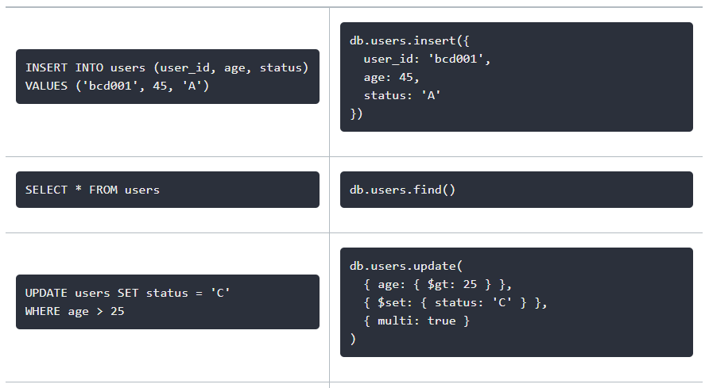
SQL to MongoDB Mapping

Slide 19
Thanks!!

